Slide 1
Cahn-Hilliard Model Using Central Space with Runge-Kutta 4th Order (RK4) Integration
Wentao Gong

Slide 2
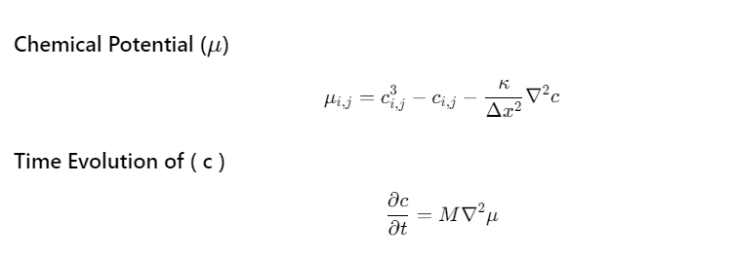
Introduction: Cahn Hilliard Equation

Slide 3
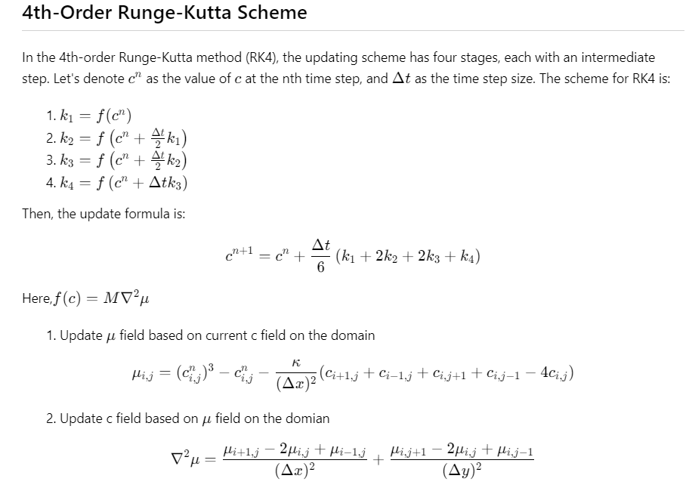
Discretization: Runge-Kutta 4th Order (RK4) and central space method

Slide 4
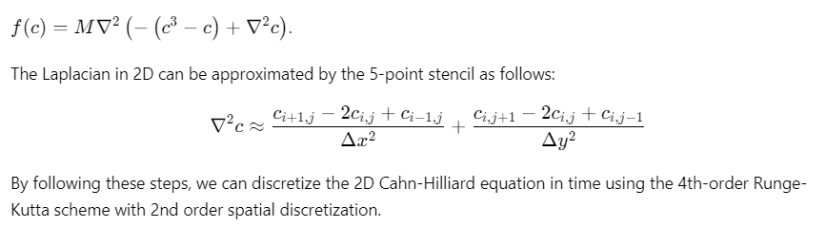
Discretization: Runge-Kutta 4th Order (RK4) and central space method

Slide 5
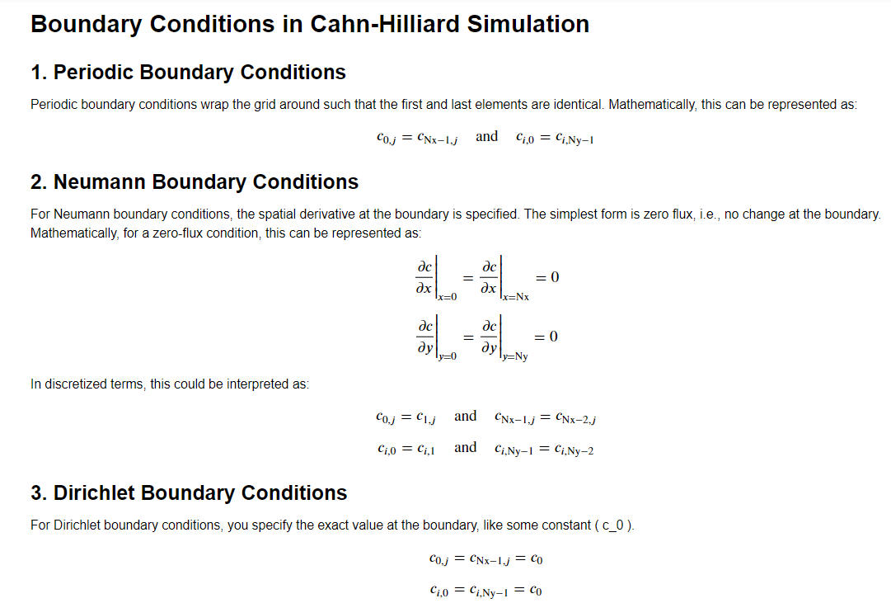

Slide 6
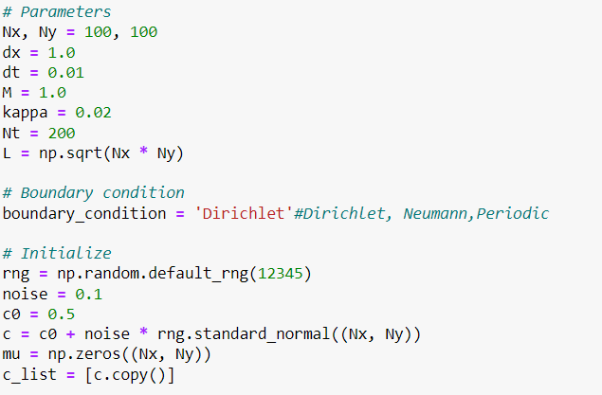

Slide 7
Case study 3: results

Slide 8
Case study 3: results

